Slide 1
Detecting Parkinson’s Disease with OpenCV, Computer Vision
Joshikha Murugesan - RA1911003010013
Vandana Rajesh - RA1911003010030
Pooja R - RA1911003010033

Slide 2
What is Parkinson’s Disease

Slide 3
Parkinson’s disease is a nervous system disorder that affects movement. The disease is progressive and is marked by five different stages.
Stage 1: Mild symptoms that do not typically interfere with daily life, including tremors and movement issues on only one side of the body.
Stage 2: Symptoms continue to become worse with both tremors and rigidity now affecting both sides of the body. Daily tasks become challenging.
Stage 3: Loss of balance and movements with falls becoming frequent and common. The patient is still capable of living independently.
Stage 4: Symptoms become severe and constraining. The patient is unable to live alone and requires help to perform daily activities.
Stage 5: Likely impossible to walk or stand. The patient is most likely wheelchair bound and may even experience hallucinations.

Slide 4
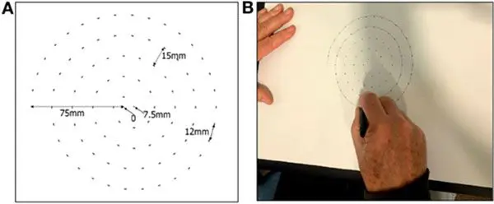
Drawing spiral & waves
The researchers found that the drawing speed was slower and the pen pressure lower among Parkinson’s patients — this was especially pronounced for patients with a more acute/advanced forms of the disease.
We’ll be leveraging the fact that two of the most common Parkinson’s symptoms include tremors and muscle rigidity which directly impact the visual appearance of a hand drawn spiral and wave.

Slide 5
Objective
This is our

Slide 6
For the patients suffering from Parkinson's Disease, it has been observed that impairment in the handwriting is directly proportional to the severity of the disease. Also, the speed and pressure applied to the pen while sketching or writing something are also much lower in patients suffering from Parkinson's disease. Therefore, correctly identifying such biomarkers accurately and precisely at the onset of the disease will lead to a better clinical diagnosis. Henceforth, in this project, a system design is proposed for analyzing Spiral drawing patterns and wave drawing patterns in patients suffering from Parkinson's disease and healthy subjects.

Slide 7
Dataset
The first step,

Slide 8
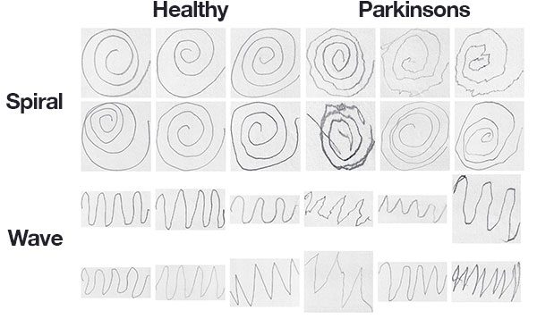
Spiral & Wave dataset

Slide 9
Spiral and Wave Dataset
The dataset itself consists of 204 images and is pre-split into a training set and a testing set, consisting of:
Spiral: 102 images, 72 training, and 30 testing
Wave: 102 images, 72 training, and 30 testing
(While it would be challenging, if not impossible, for a person to classify Parkinson’s vs. healthy in some of these drawings, others show a clear deviation in visual appearance, our goal is to quantify the visual appearance of these drawings and then train a machine learning model to classify them.)

Slide 10
Spiral and Wave Dataset
Our dataset is first broken down into spiral and wave . Each of those folders is further split into testing and training . Finally our images reside in healthy or parkinson's folders.

Slide 11
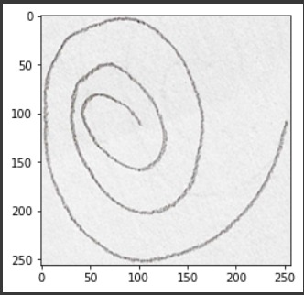
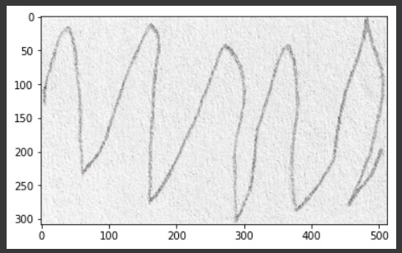
Sample Spiral and Sample Wave

Slide 12
Softwares Used
Listing the

Slide 13
Computing Environments:
OpenCV
NumPy
imutils
Scikit-learn
Scikit-image

Slide 14
Implementation & Approach

Slide 15
Implementation
To implement our Parkinson’s detector that predominantly contains image dataset ,we would be tempted to throw deep learning and Convolutional Neural Networks (CNNs) at the problem — there’s a problem with that approach though.

Slide 16
Implementation
To start, we don’t have much training data, only 72 images for training. When confronted with a lack of tracking data we typically apply data augmentation — but data augmentation in this context is also problematic.
You would need to be extremely careful as improper use of data augmentation could potentially make a healthy patient’s drawing look like a Parkinson’s patient’s drawing (or vice versa).

Slide 17
Approach
The models that we use decide the way we approached the project. And here we used two popular machine learning algorithms:
Logistic Regression
Random Forest

Slide 18
Approach
Logistic Regression
Logistic regression is a supervised learning classification algorithm used to predict the probability of a target variable. The nature of target or dependent variable is dichotomous, which means there would be only two possible classes.Which are (yes/no) events, which by approach suits our system very well, since we’ll be computing if the person is having parkinson’s or not.
Random Forest
Random forest is a Supervised Machine Learning Algorithm that is used widely in Classification and Regression problems. It builds decision trees on different samples and takes their majority vote for classification and average in case of regression, which also caters to our needs.

Slide 19
Before we talk about our group went with two different models, let’s discuss an important feature in our system,an image detector HOG.
Histogram of Oriented Gradients

Slide 20
Histogram of Oriented Gradients
Histogram of Oriented Gradients, or HOG for short, are descriptors mainly used in computer vision and machine learning for object detection. However, we can also use HOG descriptors for quantifying and representing both shape and texture.
HOG descriptors are mainly used to describe the structural shape and appearance of an object in an image, making them excellent descriptors for object classification. However, since HOG captures local intensity gradients and edge directions, it also makes for a good texture descriptor.

Slide 21
The HOG descriptor returns a real-valued feature vector. The dimensionality of this feature vector is dependent on the parameters chosen for the orientations , pixels_per_cell , and cells_per_block parameters.
The resulting features are a 12,996-dim feature vector (list of numbers) quantifying the wave or spiral.

Slide 22
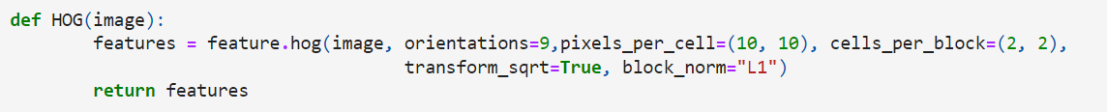
Here, for our models, the features are extracted via our quantify_image function. The features and label are appended to the data and labels lists respectively. Finally data and labels are converted to NumPy arrays and returned conveniently in a tuple.

Slide 23
Why our logistic regression model had low accuracy?

Slide 24
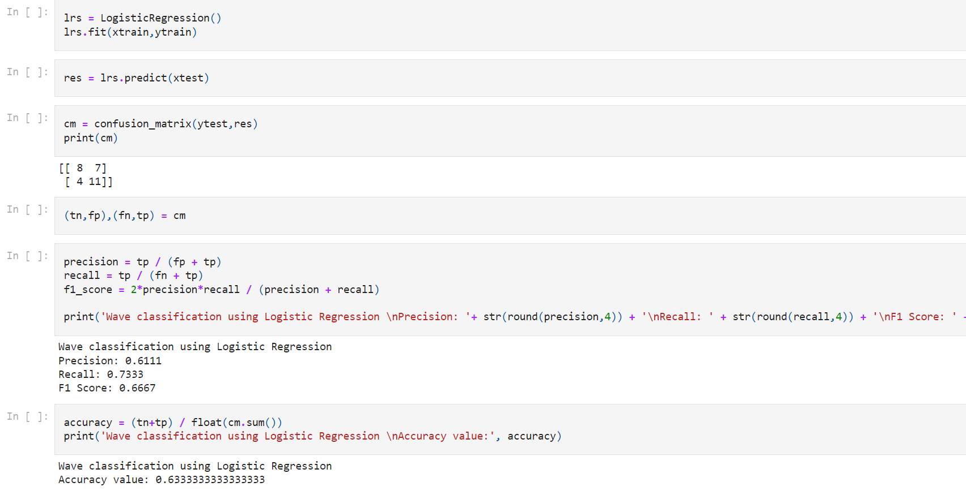
Logistic Regression Wave Classification

Slide 25
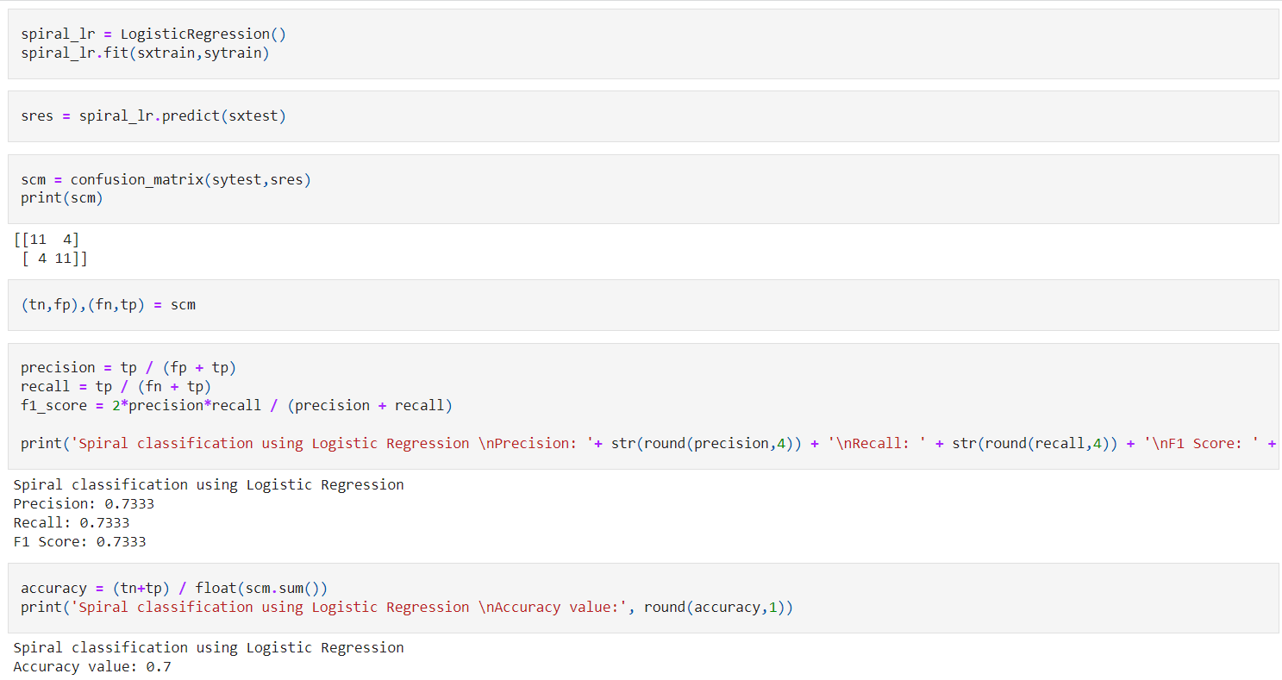
Logistic Regression Spiral Classification

Slide 26
Logistic regression is a very commonly used method for predicting a target label from structured tabular data. Although there are some more advanced methods that generally perform better, the simplicity of logistic regression makes it the first choice.
But it is also important to understand the limitations of logistic regression.
The idea behind the generation of this dataset is pretty simple, there were plenty of data points, and no noise at all, the logistic regression model performed poorly on this dataset.
The reason is that the target label has no linear correlation with the features. In such cases, logistic regression (or linear regression for regression problems) can’t predict targets with good accuracy (even on the training data).

Slide 27
Random Forest
On the other hand,

Slide 28
Random forest is a Supervised Machine Learning Algorithm that is used widely in Classification and Regression problems. It builds decision trees on different samples and takes their majority vote for classification and average in case of regression.
Random forest is a flexible, easy to use machine learning algorithm that produces, even without hyper-parameter tuning, a great result most of the time. It is also one of the most used algorithms, because of its simplicity and diversity (it can be used for both classification and regression tasks).
In general, logistic regression performs better when the number of noise variables is less than or equal to the number of explanatory variables and random forest has a higher true and false positive rate as the number of explanatory variables increases in a dataset.

Slide 29
In general, logistic regression performs better when the number of noise variables is less than or equal to the number of explanatory variables and random forest has a higher true and false positive rate as the number of explanatory variables increases in a dataset.
A random forest produces good predictions that can be understood easily. It can handle large datasets efficiently. The random forest algorithm provides a higher level of accuracy in predicting outcomes over the decision tree algorithm.
It can perform both regression and classification tasks.

Slide 30


Our Results

Slide 31
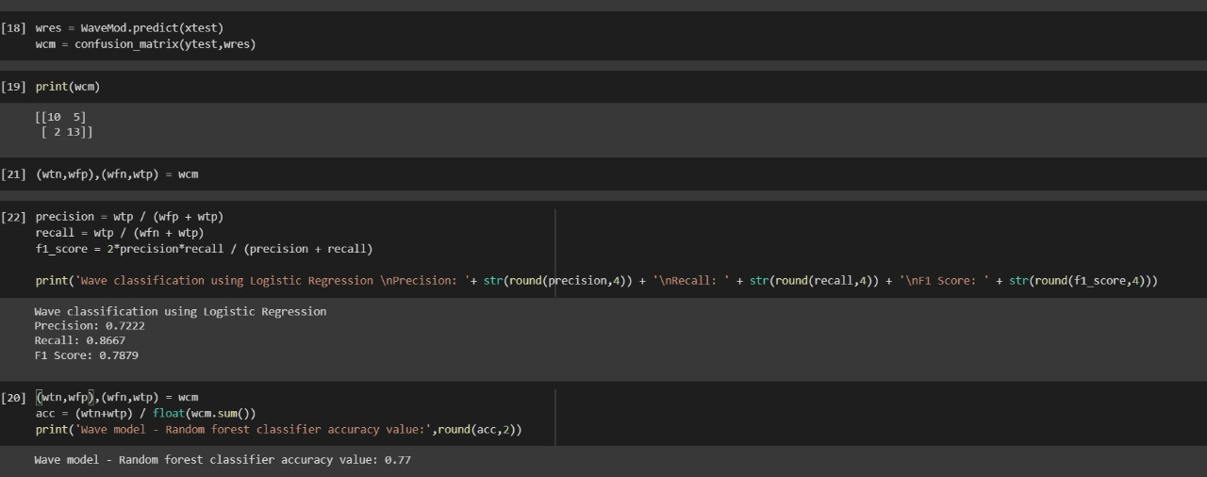
Random Forest Wave Classification
Accuracy : 77%

Slide 32
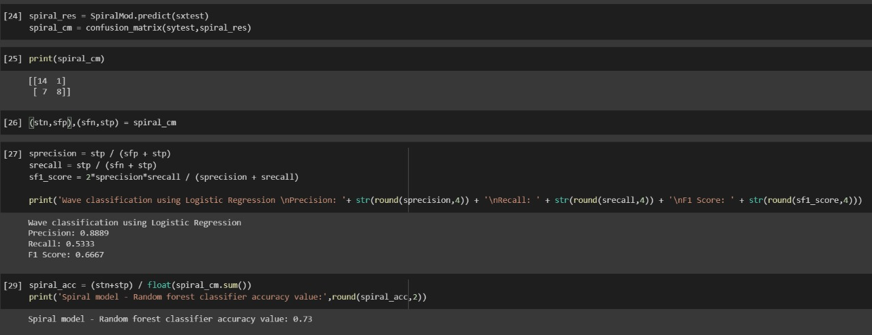
Random Forest Spiral Classification
Accuracy : 73%

Slide 33
Conclusion

Slide 34
After extracting features from the input images we trained a Random Forest classifier with 100 total decision trees in the forest, obtaining:
77% accuracy for spiral
73% accuracy for the wave

Slide 35
Thank you

